Slide 2



Facebook for developers- Introduction
Bhavin Jawade
Co-Lead Facebook Developer Circles Indore

Slide 3
Facebook for developers
Contents
01 Artificial Intelligence 02 Augmented Reality
03 Business Tools
04 Open Source
05 Virtual Reality

Slide 4
Facebook for developers
Artificial Intelligence
Facebook for developers

Slide 5


Facebook for developers
AI tools by facebook
Framework for deep learning
Fast Natural Language Processing for
Creating chatbots

Slide 6

Facebook for developers
QuickStart- https://wit.ai/docs/quickstart
Console- https://wit.ai/home

Slide 7
Facebook for developers
Augmented Reality
Facebook for developers

Slide 8


Facebook for developers
AR Studio
Currently only available for mac
Download- developers.facebook.com/products/ar-studio
Tutorial- developers.facebook.com/docs/ar-studio/tutorials

Slide 9

VIDEO - https://www.youtube.com/watch?v=2AvnnIZ7qbs

Slide 10
Facebook for developers
Business Tools
Facebook for developers

Slide 11
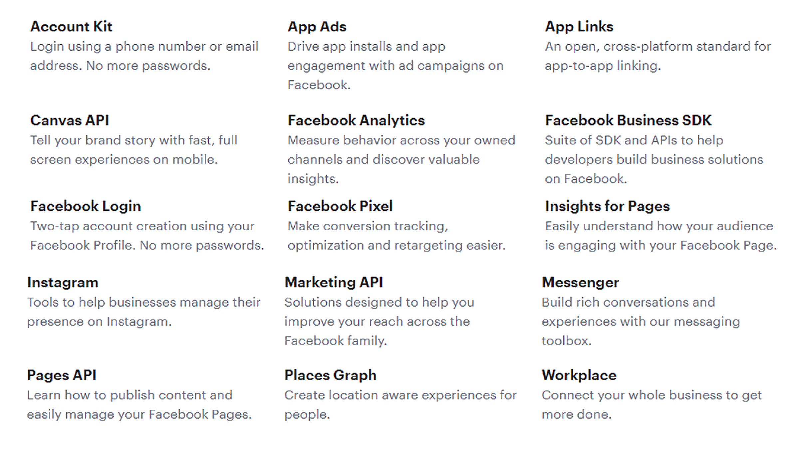
Facebook for developers

Slide 12
Facebook for developers
Open Source by Facebook
Facebook for developers

Slide 13

React
React Native
Detectron
Jest
Duckling
Reason
Duckling

Slide 14
Facebook for developers
Duckling
Haskell library to parse text into structured data
Quantity | "3 cups of sugar" | {"value":3,"type":"value","product":"sugar","unit":"cup"}
Temperature | "80F" | {"value":80,"type":"value","unit":"fahrenheit"}
Time | "today at 9am" | {"values":[{"value":"2016-12-14T09:00:00.000-08:00","grain":"hour","type":"value"}],"value":"2016-12-14T09:00:00.000-08:00","grain":"hour","type":"value"}
Url | "https://api.wit.ai/message?q=hi" | {"value":"https://api.wit.ai/message?q=hi","domain":"api.wit.ai"}

Slide 15

Facebook for developers
JEST
JavaScript testing platform
Zero configuration testing platform
Jest is used by Facebook to test all JavaScript code including React applications. One of Jest's philosophies is to provide an integrated "zero-configuration" experience. We observed that when engineers are provided with ready-to-use tools, they end up writing more tests, which in turn results in more stable and healthy code bases.

Slide 16

Facebook for developers
Simple, fast and type safe JavaScript
quality type safe code while leveraging both the
JavaScript & OCaml ecosystems.
type schoolPerson = Teacher | Director | Student(string);
let greeting = stranger => switch (stranger) {
| Teacher => "Hey professor!“
| Director => "Hello director."
| Student("Richard") => "Still here Ricky?"
|Student(anyOtherName) => "Hey, " ++ anyOtherName ++ "."
};

Slide 17
Facebook for developers
Virtual Reality
Facebook for developers

Slide 18


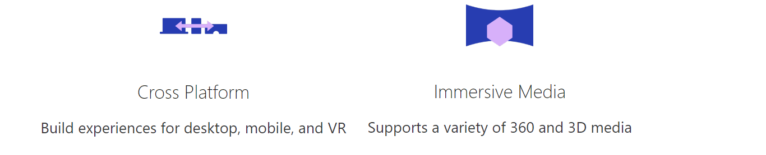
Facebook for developers
React 360
Create exciting 360 and VR experiences using React
Deploy your creation across the
web to desktop, mobile, and VR devices

Slide 19

Thank You

